Slide 1
Unit 3B
Human Diversity & Change
Variation & evolution
Hominin evolution

Slide 2

Study Guide
Read:
Chapter 18 Human Perspectives.

Slide 3
Who were the hominins?
The hominins (sometimes referred to as hominids) are a group of hominoids (apes and humans) who habitually stood upright and moved bipedally.
This group includes modern humans and their ancestors since they diverged from the ape lineage.
The most important genera are Homo and Australopithecus.

Slide 4
Human classification
Kingdom Animal
Phylum Chordate
Sub-phylum Vertebrate
Class Mammal
Order Primate
Family Hominid/Hominin?
Genus Homo
Species sapiens
Scientific binomial Homo sapiens or
Homo sapiens

Slide 5
A possible family tree
Homo sapiens
Homo neanderthalensis
Homo erectus
Homo ergaster
Homo habilis
Homo rudolfensis
Robust
australopithecines
Gracile
australopithecine
Australopithecus
afarensis

Slide 6
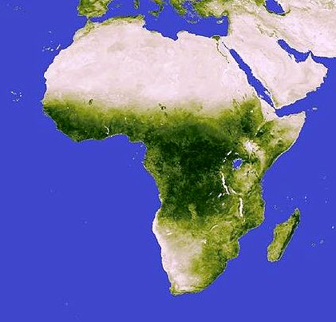
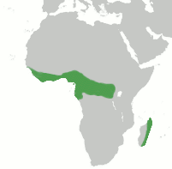
Distribution of hominids and apes
Modern-day apes are restricted to the tropical rainforest of central and western Africa.
The hominins appear to have lived in the open woodland and savanna east of the Rift Valley.
Tropical rainforest
Rift Valley system

Slide 7
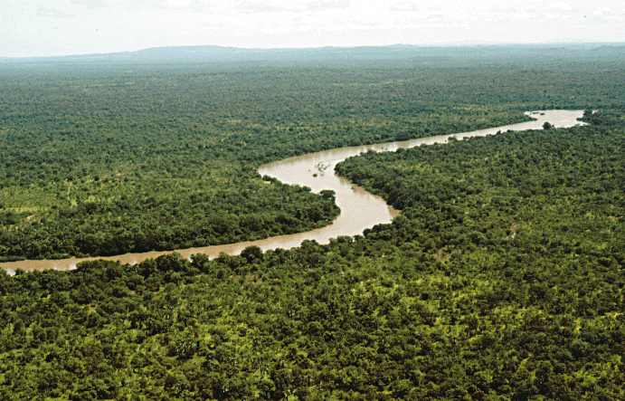
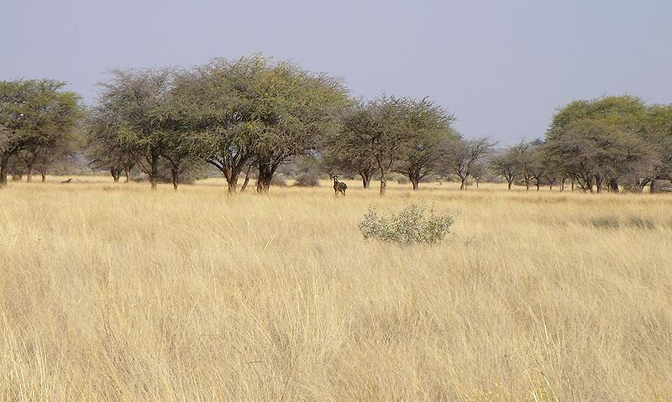
Climate change and evolution
Some scientists believe that climate change in Africa, around 3 million years ago, was the main driving force in the evolution of the hominins. The onset of cooler, drier, and more variable conditions led to a reduction in tropical rainforest and the appearance of open woodland and savanna grasslands.

Slide 8
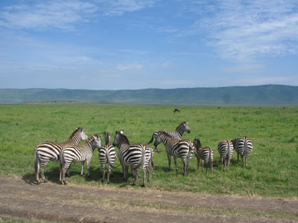
Changes to climate and vegetation coincided with changes in the fauna, including the appearance of new species of large, plant-eating mammals (a good potential food source).
It was also when the first hominins appeared.

Slide 9

Why did hominins stand upright?
Probably for a combination of reasons – e.g.
Better visibility
Can reach food on higher branches
Leaves hands free to carry food
Leaves hands free to make tools, carry weapons etc.
More energy-efficient way of walking
Less exposure to sun
Wen-Yan King

Slide 10
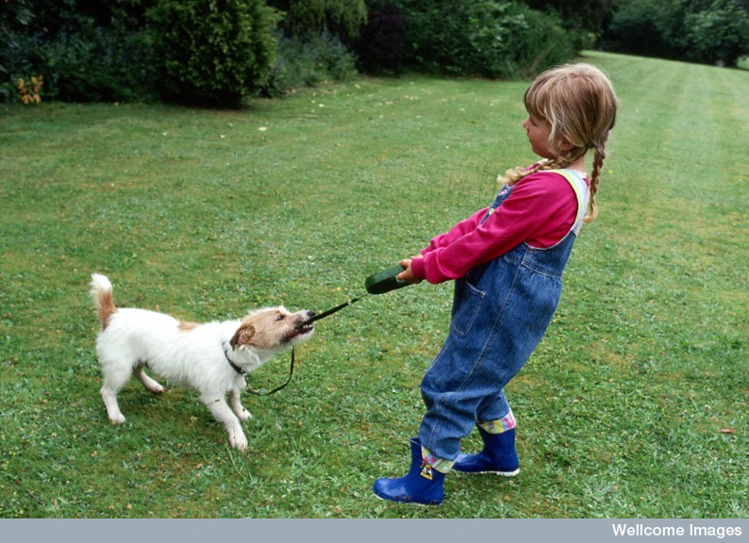
Adaptations needed for bipedalism
Anthea Sieveking, Wellcome Images

Slide 11
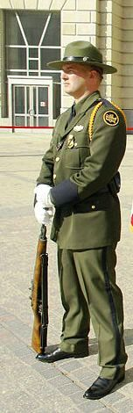
Upright bipedalism basic principles
In order to stand upright our centre of balance has to fall within the area described by our feet.
By standing ‘at-ease’, this soldier has lowered his centre of gravity and increased the base area described by his feet. This stance is very stable.

Slide 12
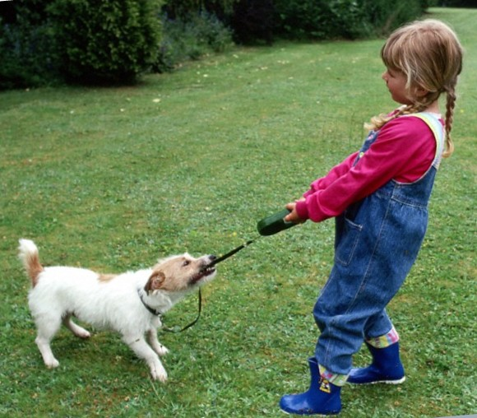
Despite having her feet apart this girl will fall over if she lets go of the leash; however, the dog won’t.
Anthea Sieveking, Wellcome Images

Slide 13
In order to become efficient upright walkers adaptation were needed to:
Bring the weight of the body above the feet.
Support the weight of the upper body.
Improve the efficiency of the striding gait.

Slide 14
Human features that assist in upright stance & bipedal locomotion
Foramen magnum more anterior | Skull better balanced Brings centre of balance over feet
Face less prognathic | Ditto
Shorter arms | Arms/legs can move faster
Smaller neck muscles | Consequence of above

Slide 15
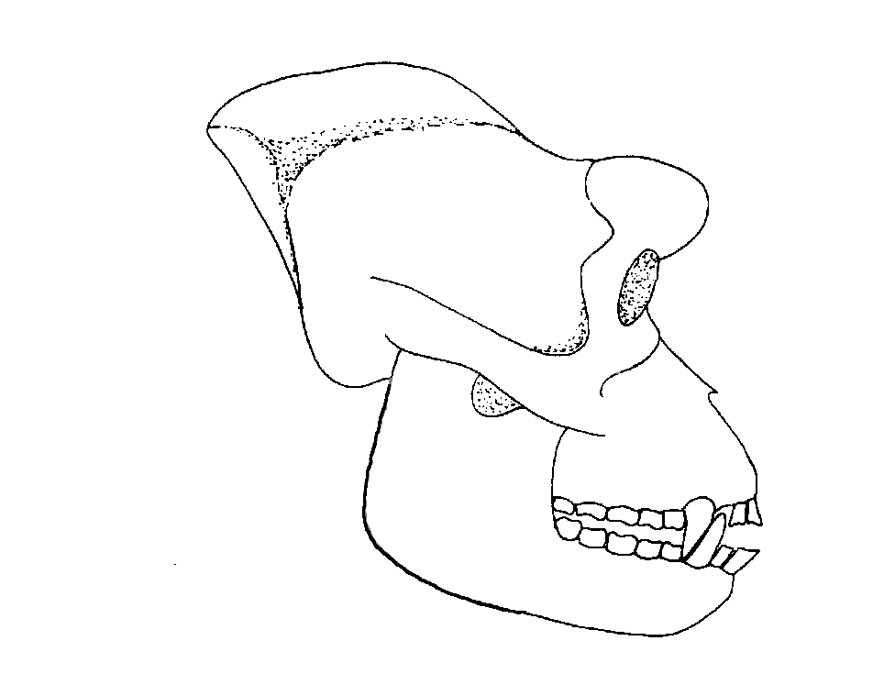
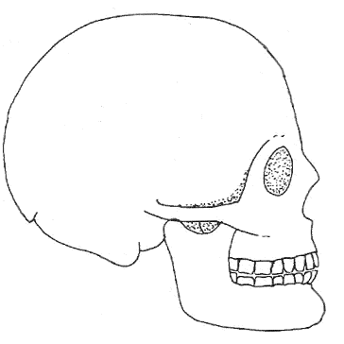
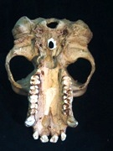
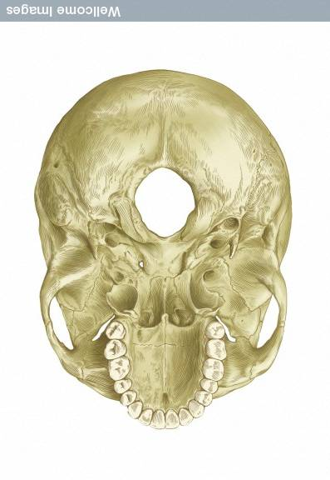
APE
HUMAN
Prognathism
Spinal cord
Nuchal area for neck muscle attachment
Foramen magnum
In humans the face is flatter and the foramen magnum is more anterior.

Slide 16
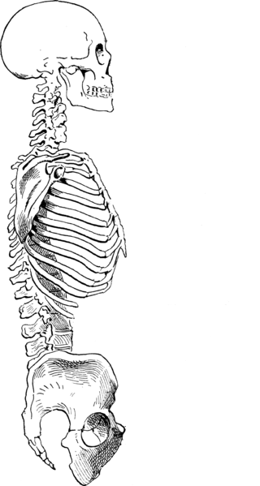
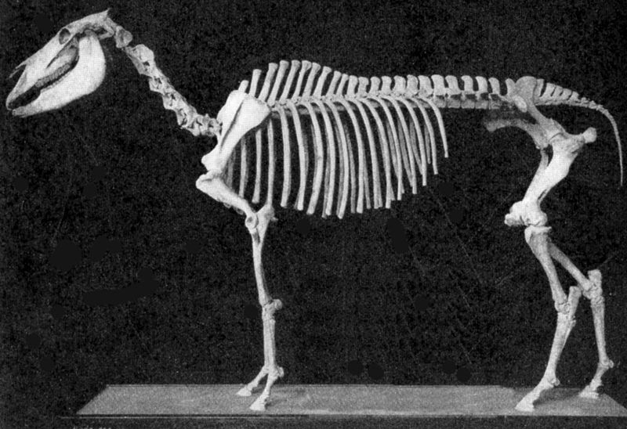
In humans, a pronounced inward curve has developed in the lumbar region of the spine and the pelvis has been tilted into an upright position.
Lumbar curve

Slide 17
Upright bipedalism - 2
Lumbar curve | Straightens spine Brings centre of balance over feet
Short, robust lumbar vertebrae | Support weight of upper body
Pelvis shorter & broader | Ditto
Pelvis tilted to vertical position | Brings centre of balance over feet

Slide 18
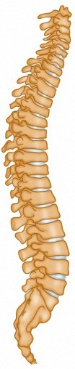
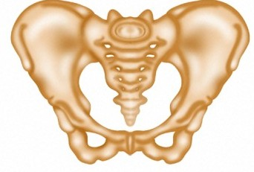
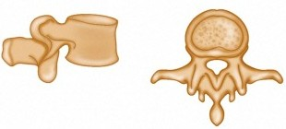
The lumbar vertebrae become robust and the pelvis becomes short and bowl-shaped. Both structure are now load-bearing, carrying the weight of the upper body.
Lumbar curve
Wellcome Photo Library

Slide 19
Upright bipedalism - 3
Gluteus medius modified | Improves stride
Femur develops carrying angle | Ditto
Femur longer | Ditto

Slide 20
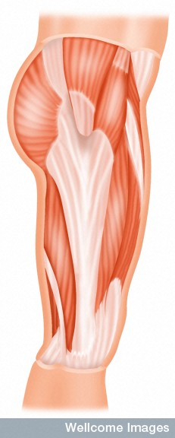
The roles of the gluteus maximus and gluteus medius are modified.
The gluteus maximus becomes an extensor (i.e. it pulls the thigh backwards).
The gluteus medius stabilises the pelvis when we bear the weight of the body on one foot.
Gluteus medius
Gluteus maximus

Slide 21
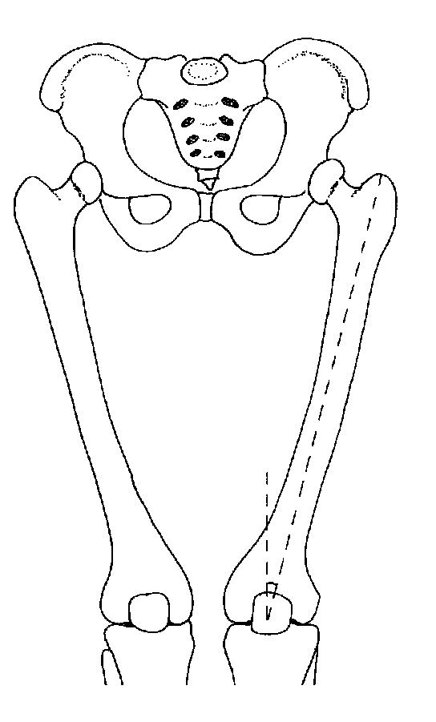
The development of a carrying angle facilitates the striding gait. It also brings the weight of the body onto the outer condyle.

Slide 22
Upright bipedalism - 4
Larger calcaneus (heel) | Improves flexion of foot
Longitudinal & transverse arch | Transfers energy from Achilles tendon to big toe
Robust, non-opposable big toe | Improves stride - Provides thrust

Slide 23
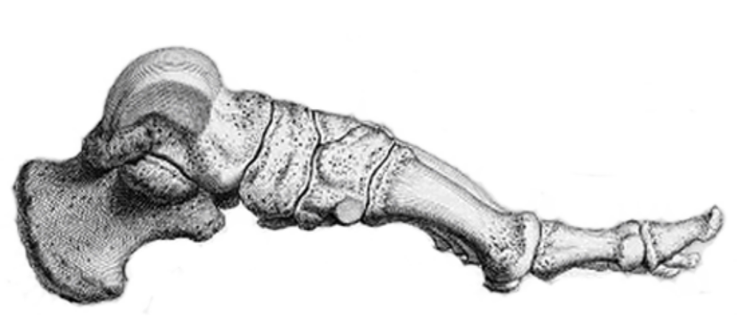
The foot has become a weight-bearing platform and the main structure for propulsion.
Large calcaneus
Robust big toe aligned with other toes
Longitudinal & transverse arches

Slide 24
Hominin evolution
The first evolutionary change that distinguished hominins from the apes was the development of upright bipedalism.
This was followed by the appearance of more human-like dentition. The teeth of 3 million-year-old fossils of A. afarensis still have ape features (e.g. a diastema and large canine teeth).
The expansion of the brain marks the appearance of our own genus, Homo, around 2.3 million years ago.

Slide 25
Hominin evolution
The first evidence of an upright-walking biped goes back 6 million years (Orrorin tugenensis).
It is believed that this creature was a tree climbing biped (much like later australopithecines and modern chimpanzees).
How O. tugenensis fits into the human family tree remains unknown.

Slide 26
Trends in hominin evolution the skull
These features are least well developed in early hominids (e.g. australopithecines) and are generally most highly developed in modern humans.
Brain / cranium become larger, especially in the genus Homo
(450 → 1750cm³)
Foramen magnum moves towards centre of cranium
Sagittal crest for attachment of jaw muscles found only in A. boisei
Nuchal area for attachment of neck muscles becomes smaller
Cranium becomes smoother and more domed
Brow ridge becomes smaller
Temporal filling eliminates waisting in temporal area
Facial profile becomes flatter – less prognathism of the upper jaw.

Slide 27
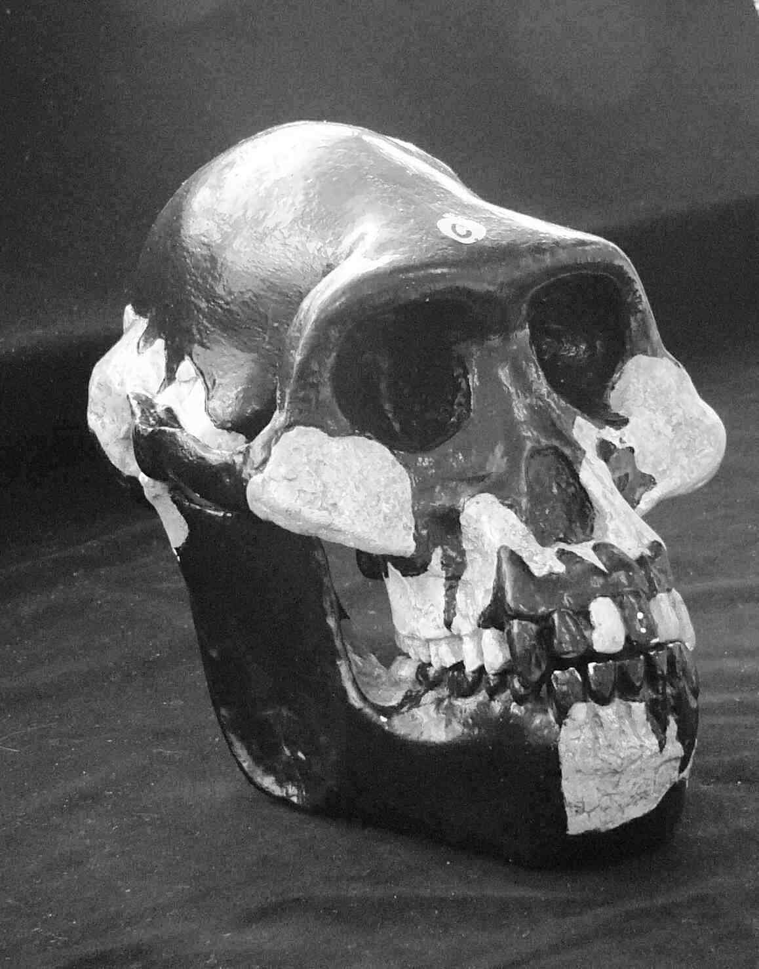
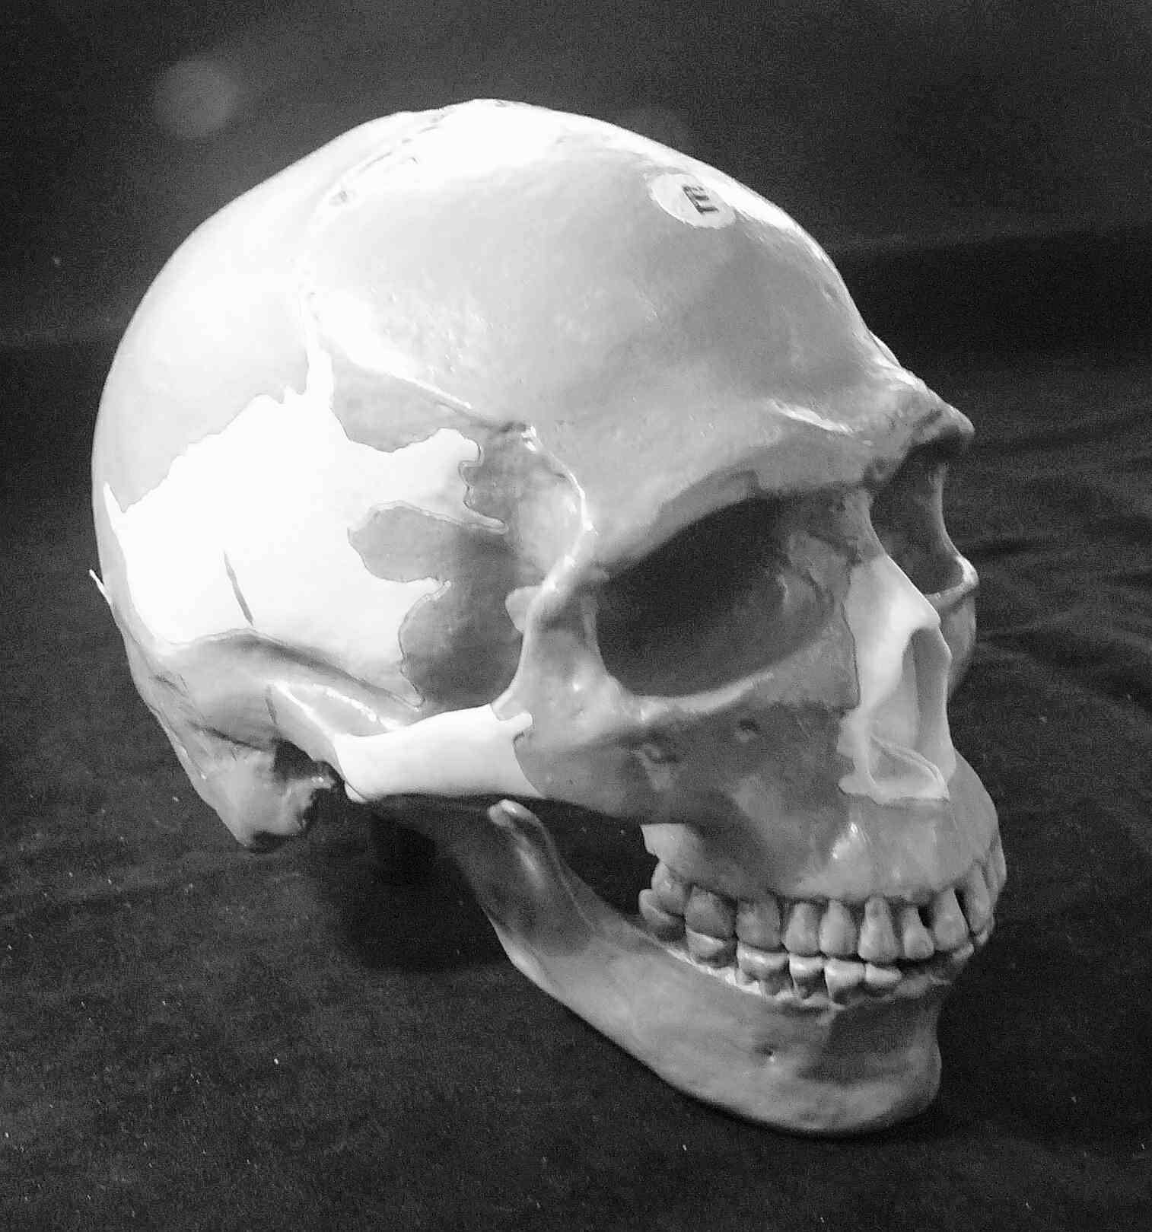
Hominid evolutionary trends
Australopithecus afarensis
Homo sapiens

Slide 28
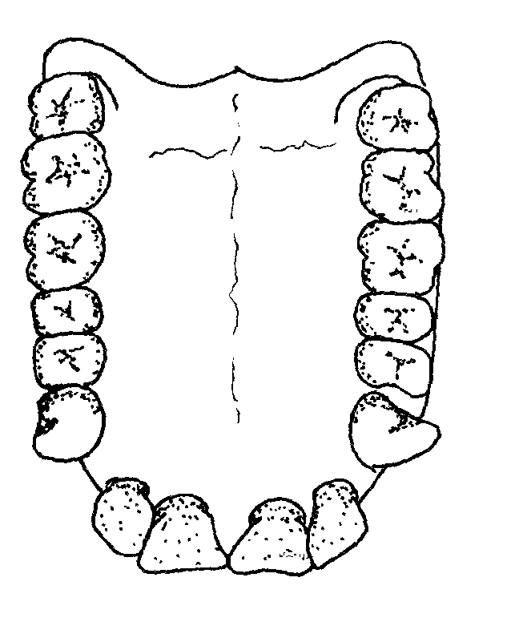
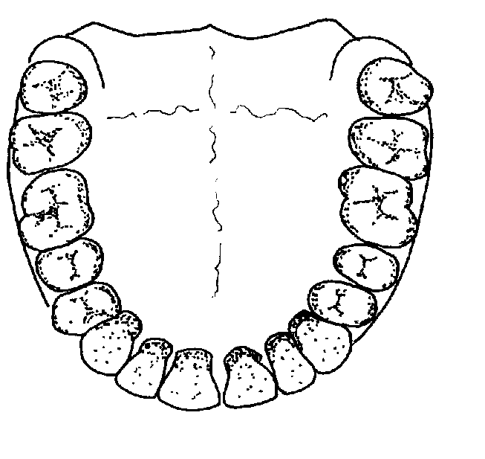
Hominid evolutionary trends jaws and dentition
Diastema
Dental arcade becomes more parabolic
All teeth become similar in size
No diastema
Lower jaw and teeth become smaller
Chin develops in modern humans
Homo sapiens

Slide 29
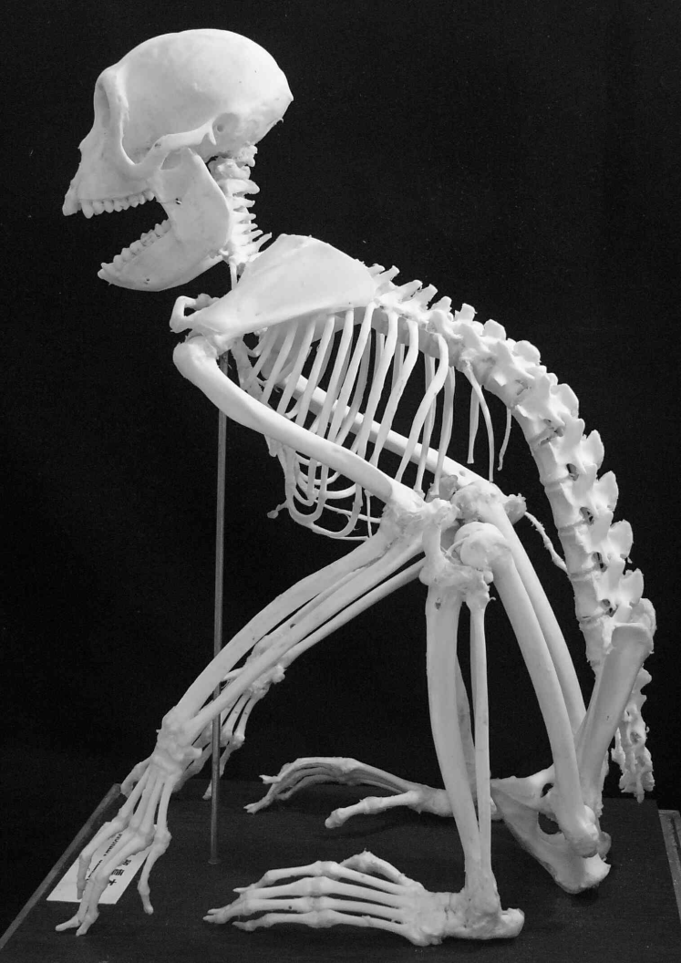
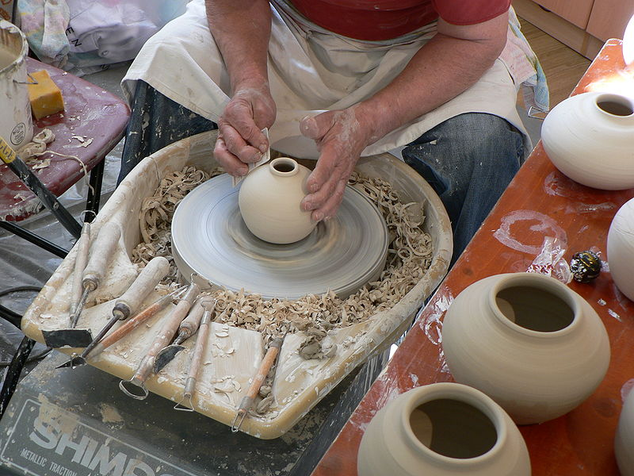
During the course of hominin evolution the arms have become shorter and the manipulative ability of the hands has improved.

Slide 30
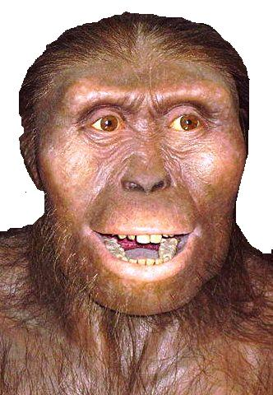
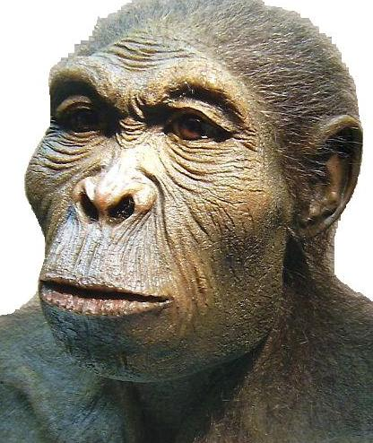

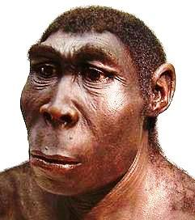
Meet the family
Australopithecus
Homo habilis
Homo sapiens
Homo erectus

Slide 31
The australopithecines
 |  | Where | When (million yr) | What
Gracile forms | A. afarensis A. africanus | E Africa S Africa | 4 - 2.5 3 - 2 | Ancestor to australopithecines Possible ancestor to humans
Robust forms | A. robustus A. boisei | S Africa E Africa | 2.5 - 1 | Extinct line Not ancestors to humans

Slide 32
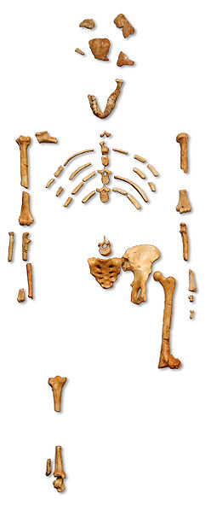

Australopithecus afarensis
Widely regarded as the ancestor of later australopithecine and hominine species.
Lived in East Africa
5 million – 3 million years ago.
Displayed a mix of ape and human features.
Lucy
GNU Free Documentation License

Slide 33
Gracile australopithecines
Gracile means lightly built.
Gracile australopithecines include the species A. afarensis and A. africanus.
A. africanus lived in southern Africa until about 2.5 million years ago.
A gracile australopithecine species was probably the ancestor of the genus Homo.

Slide 34
Robust australopithecines
Robust australopithecines were heavily built.
Robust australopithecines include the species A. robustus and A. boisei.
Robust australopithecines lived in southern and eastern Africa until about one million years ago.
Both robust species became extinct and left no descendants.

Slide 35
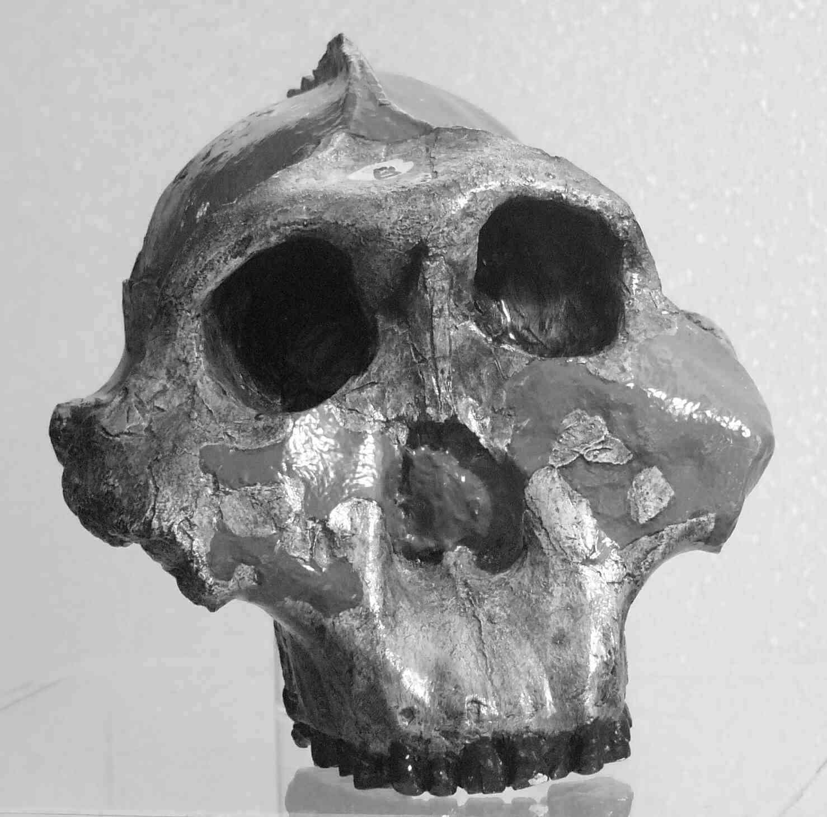
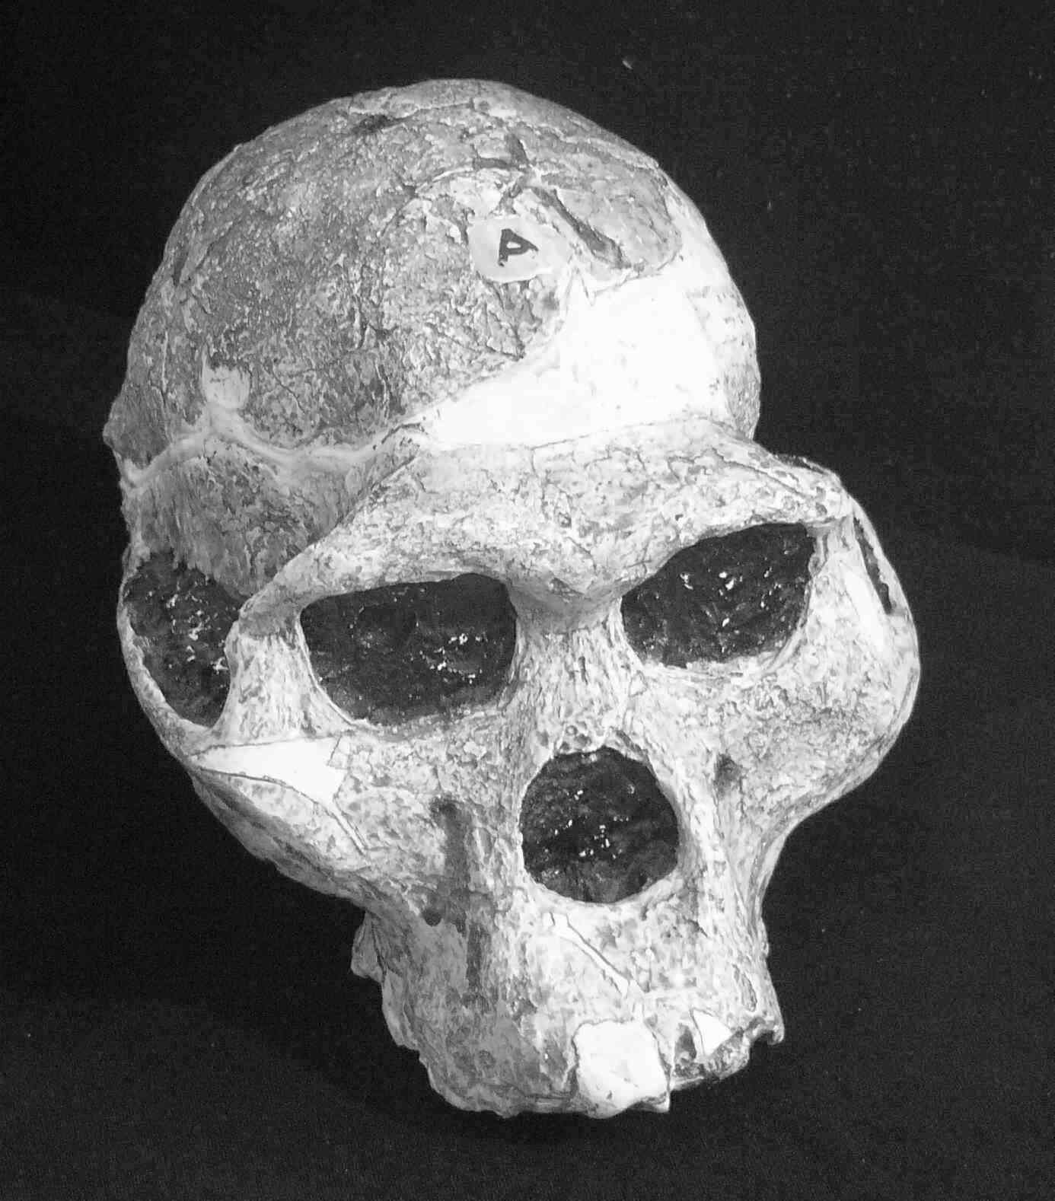
Skull models of A. boisei (a robust australopithecine) and A. africanus (a gracile australopithecine)
A. boisei
A. africanus

Slide 36
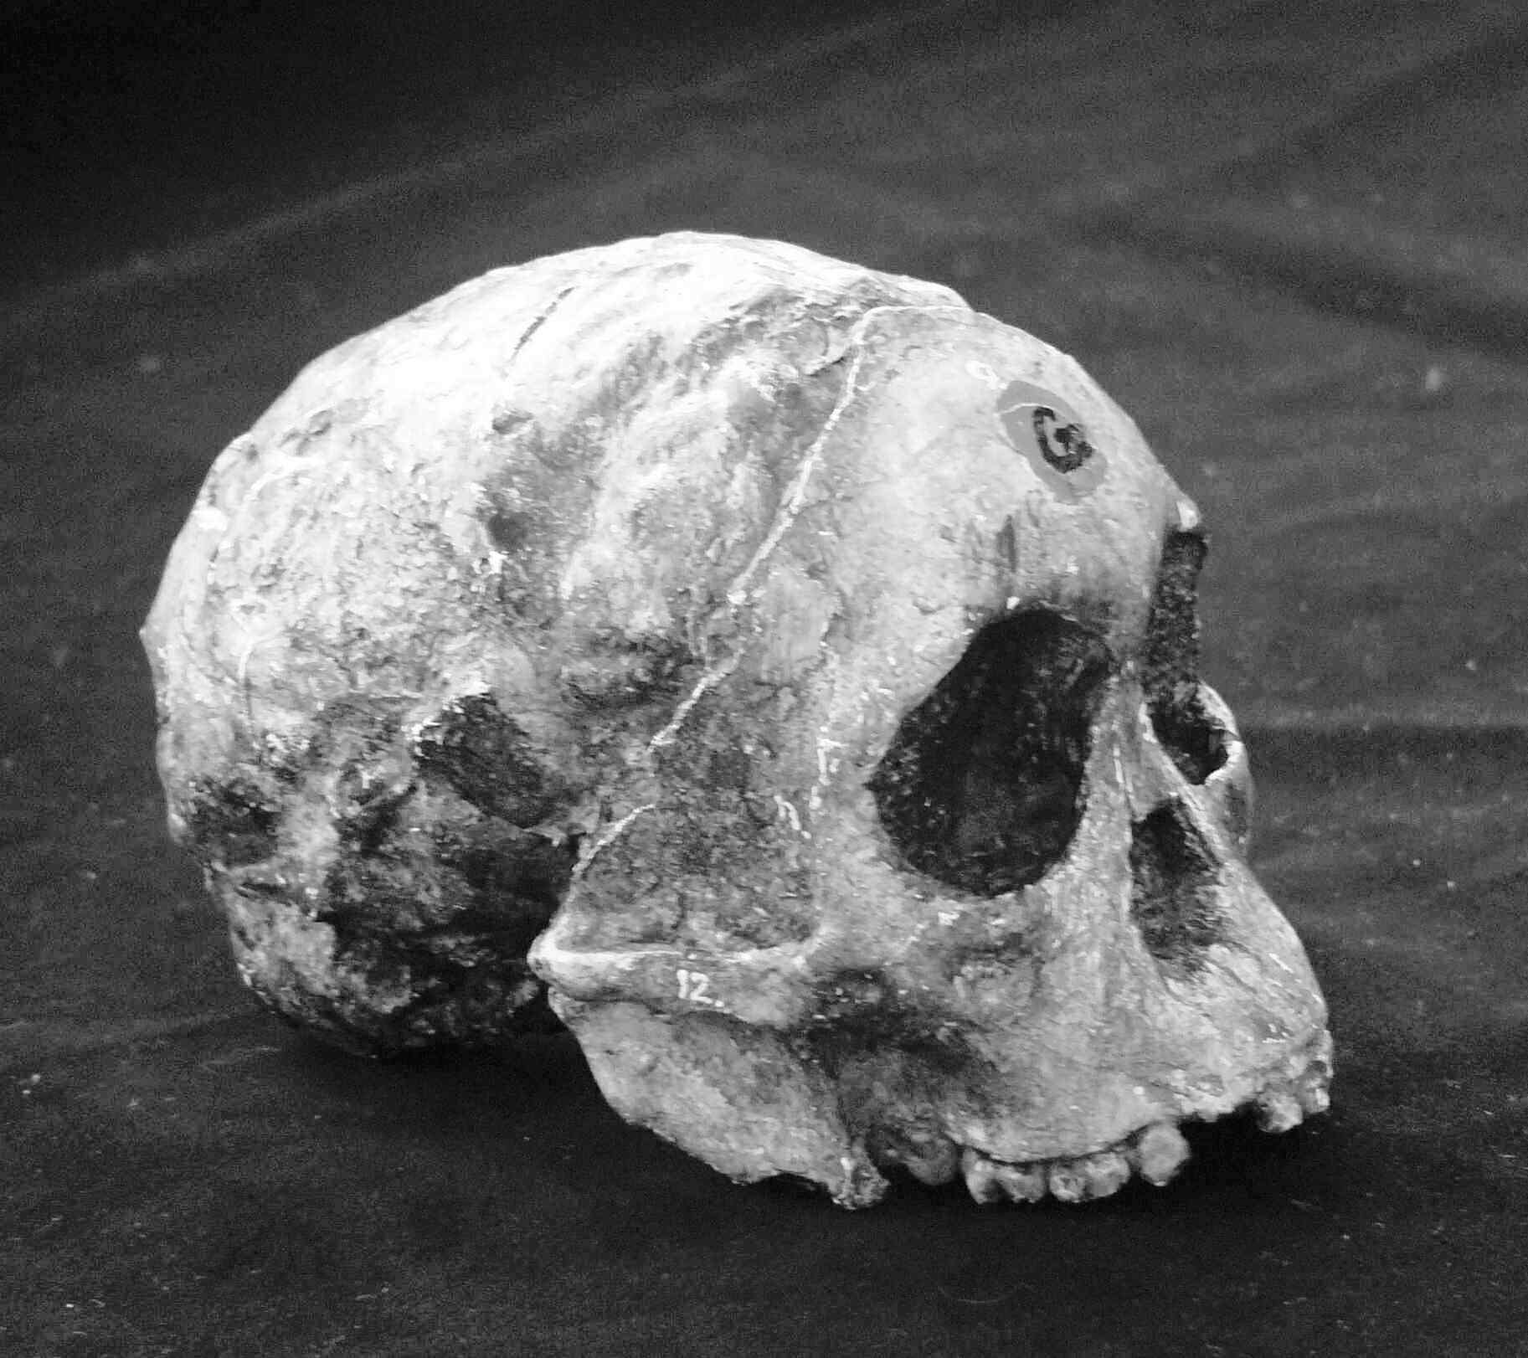
A. africanus
The Taung child

Slide 37
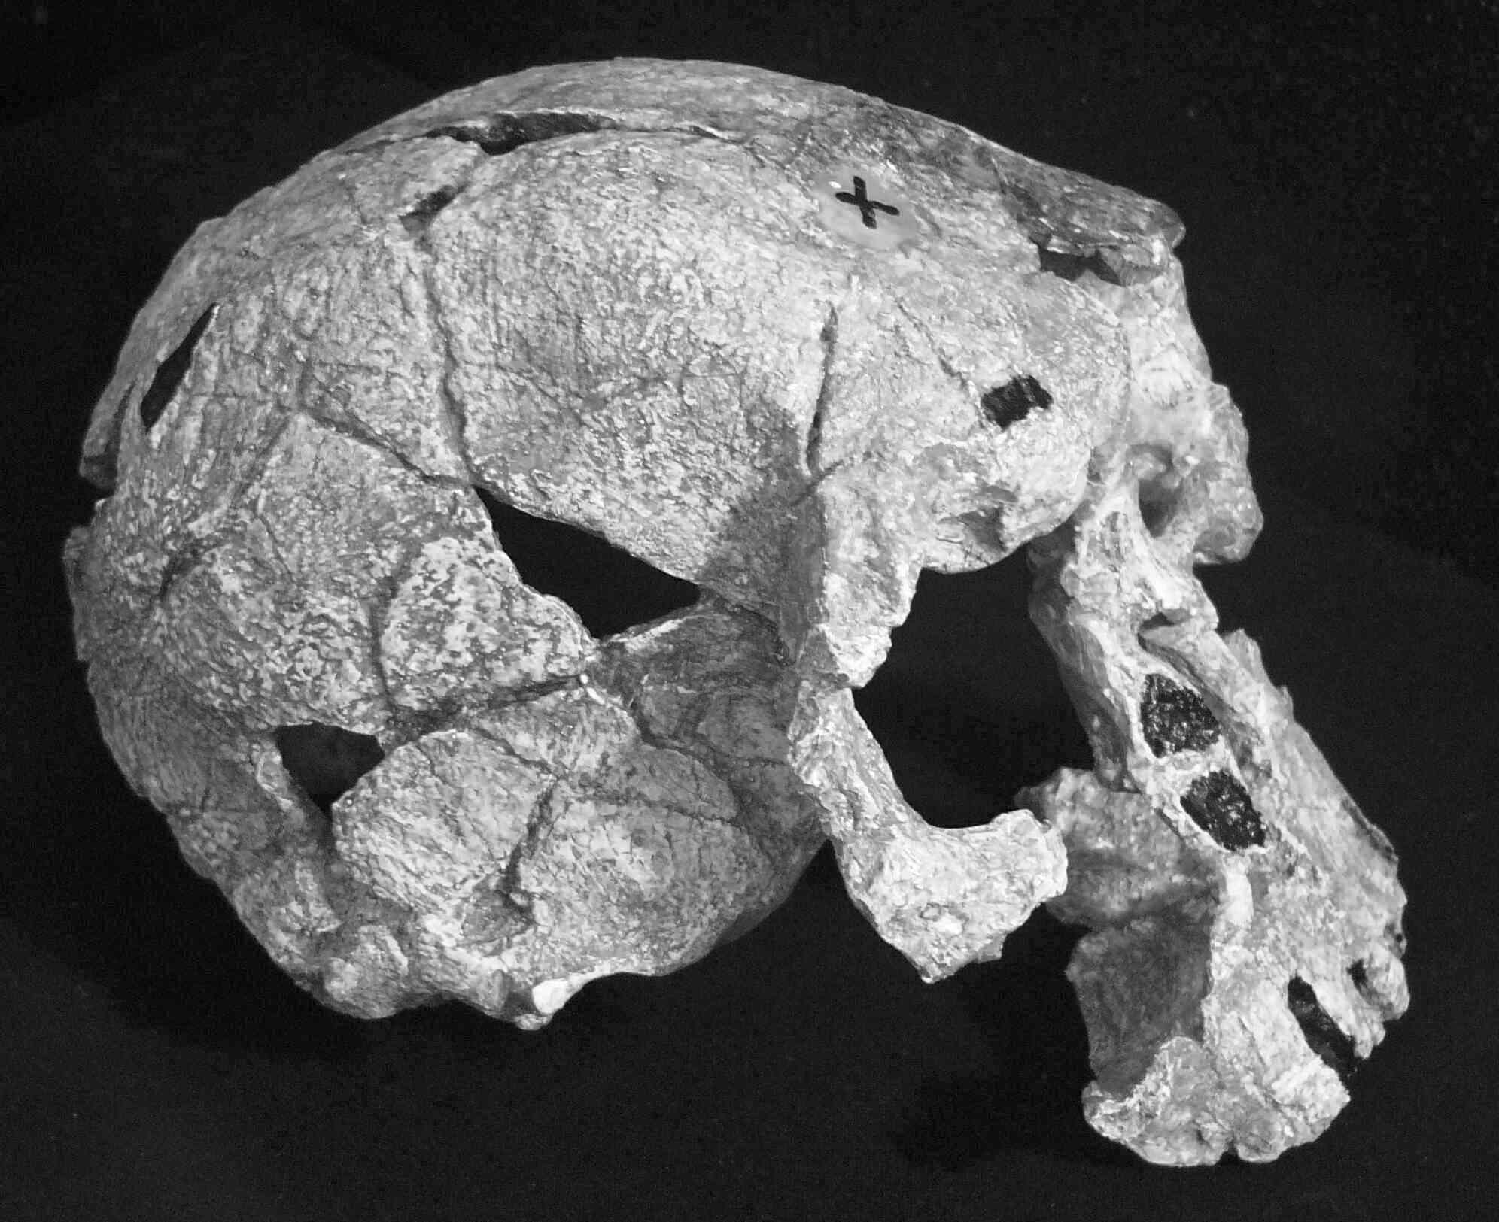
Homo habilis (H. rudolfensis)
Homo habilis had a larger brain than the australopithecines.
H. habilis lived in east Africa 2.3 - 1.8 million years ago.
H. habilis made stone tools.

Slide 38
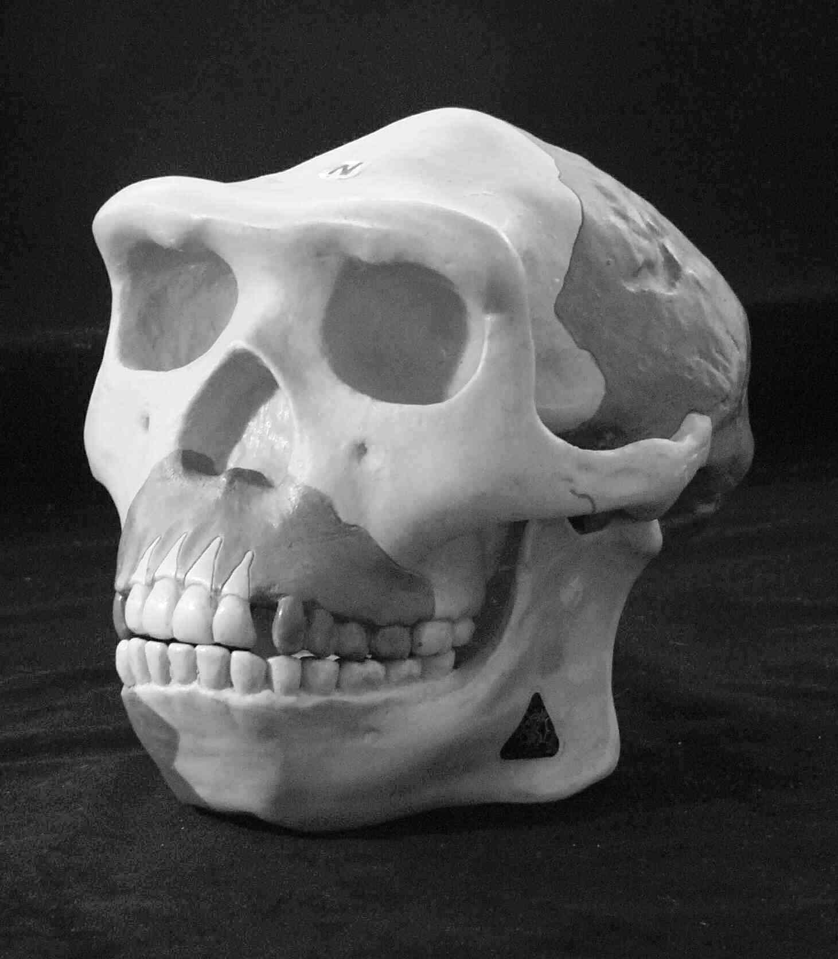
Homo erectus
H. erectus migrated out of Africa into Asia and Europe, and survived until about 50 000 years ago.
Homo erectus was probably the ancestor of H. sapiens.
Towards the end of its time range members of this species hunted for meat and used fire.

Slide 39
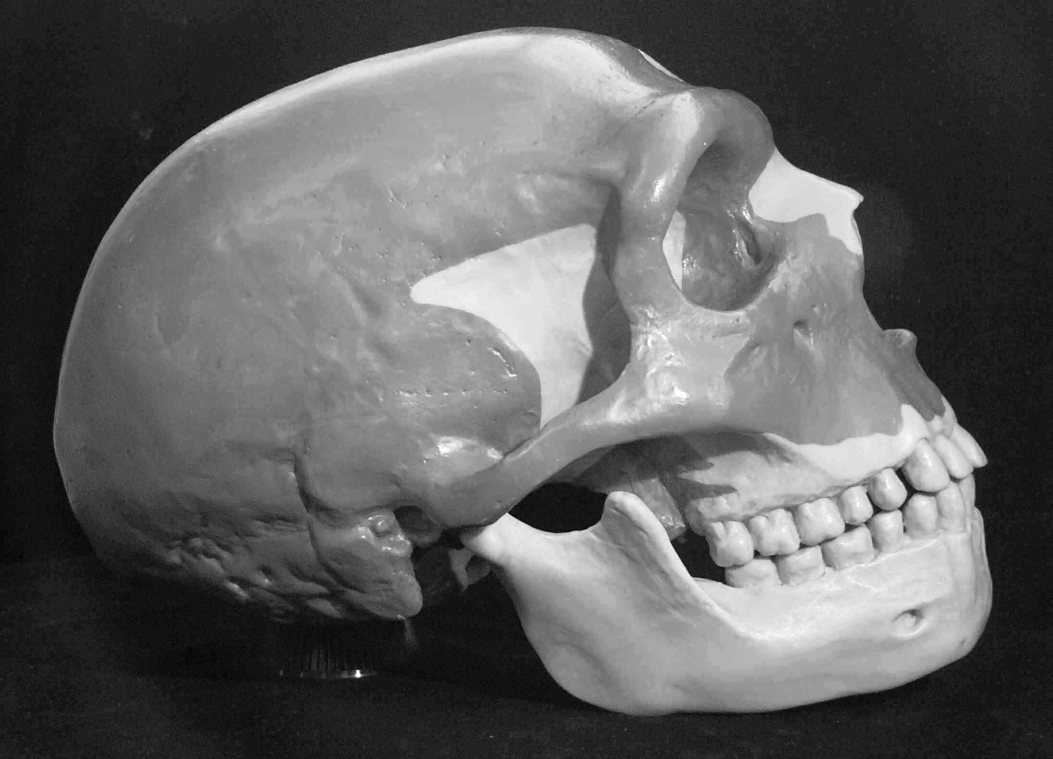
Homo neanderthalensis
Neanderthal people were ‘cousins’ of modern humans – they evolved in southern Europe during the Ice Age.
The neanderthals had large brains, and were stocky and very strong.
Neanderthals became extinct about 24 000 years ago but might have contributed to the gene pool of modern Europeans.

Slide 40
Homo sapiens
Modern humans evolved in Africa about 200 000 years ago.
They migrated out of Africa and either interbred with, or displaced, the populations of H. erectus and H. neanderthalensis they came into contact with.

Slide 41
Features of the modern human skull
Cranium/brain averages ~1400cm³
Cranium smooth and domed
Steep forehead with greatly reduced brow ridge
Temporal filling eliminates waisting in temporal area
Flat facial profile – little prognathism of the upper jaw
Small molar and pre-molar teeth
Chin

Slide 42
The origin of modern humans
Two hypotheses
1. The multiregional hypothesis
Modern H. sapiens arose independently evolving from local communities of H. erectus
[based on anatomical evidence]
2. The ‘Out of Africa’ hypothesis
Modern H. sapiens originated from modern people who evolved in Africa and migrated to Asia & Europe in the past 100-200,000 yrs [based on DNA evidence]

Slide 43
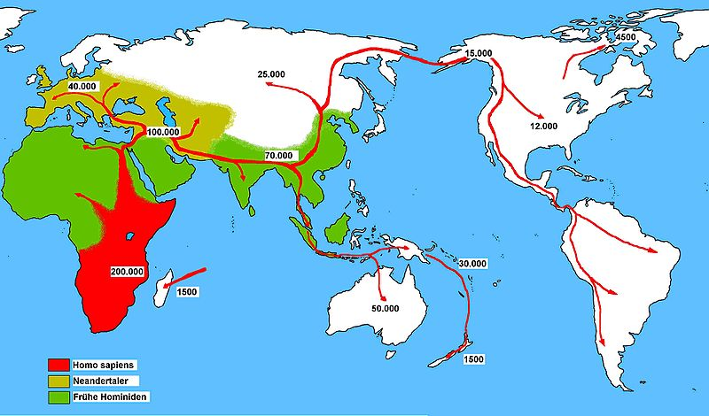
Human migration
Notes:
Homo sapiens could move from Europe across to America over an ice bridge.

Slide 44
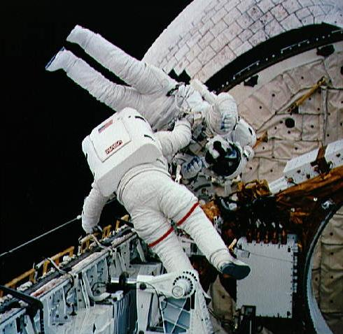
Human evolution and technology
The development of technology has largely quarantined humans from the forces that drive natural selection.

Slide 45
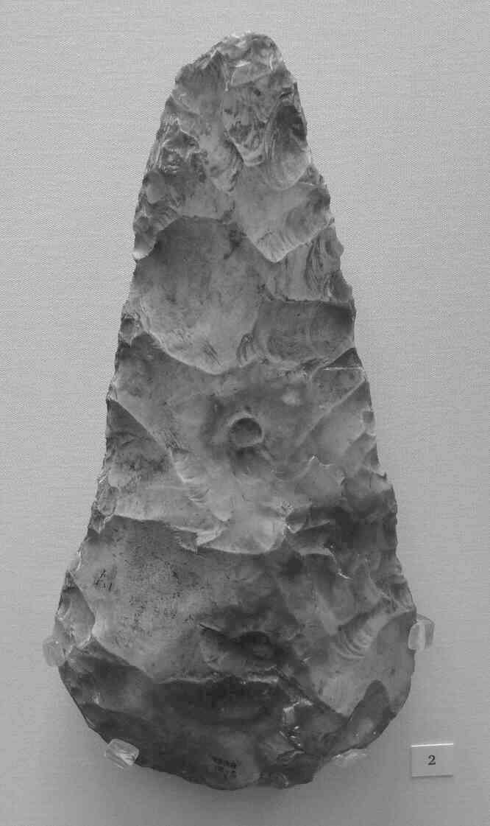
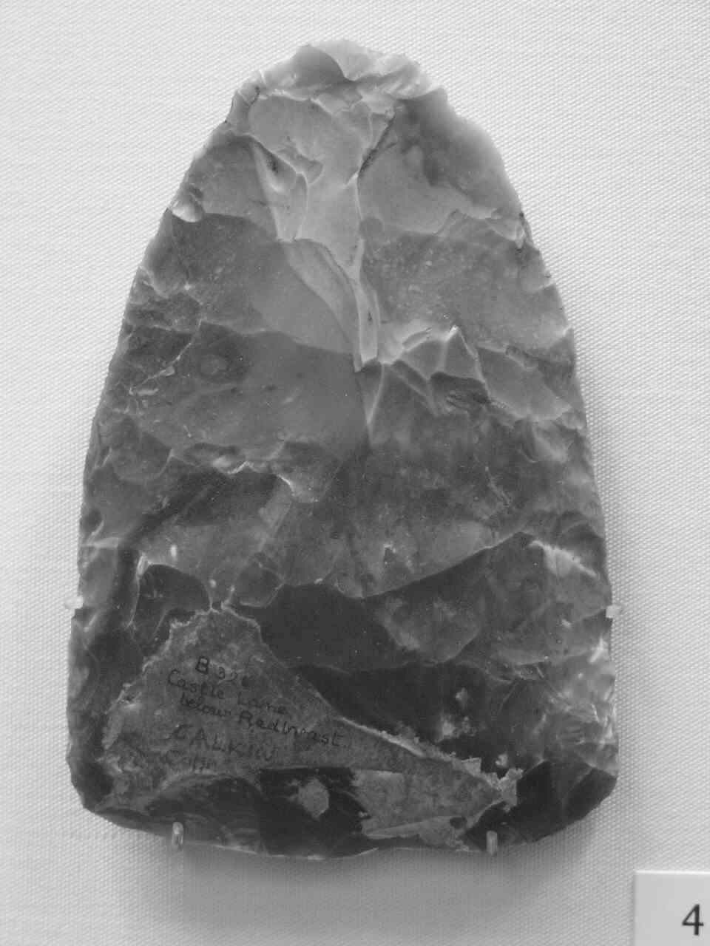
Man the tool maker
Humans have been making stone tools for more than two million years.
Tool making enabled early humans to defend themselves and exploit new food resources.

Slide 46
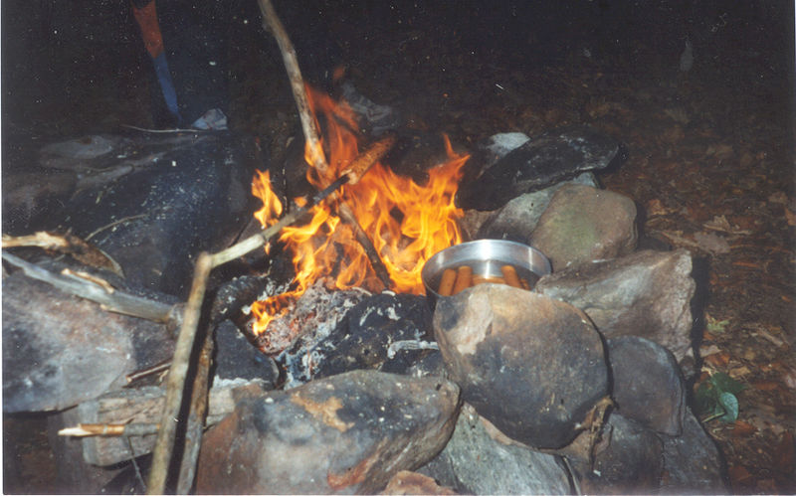
Fire
The ability to create fire provided early humans with warmth and protection against wild animals.

Slide 47
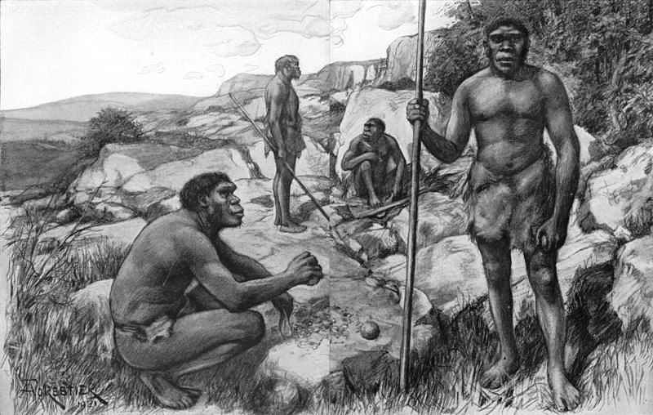
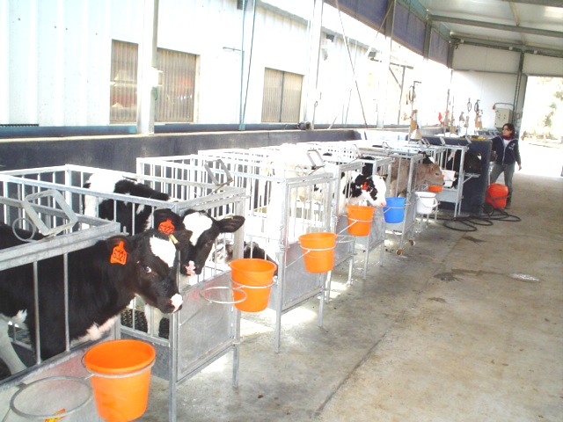
From hunter-gatherer to farmer
The transition from hunting and gathering to farming provided humans with a reliable source of food. This enabled them to settle down and build permanent towns and villages.
This stage of human development is known as the neolithic revolution.

Slide 48
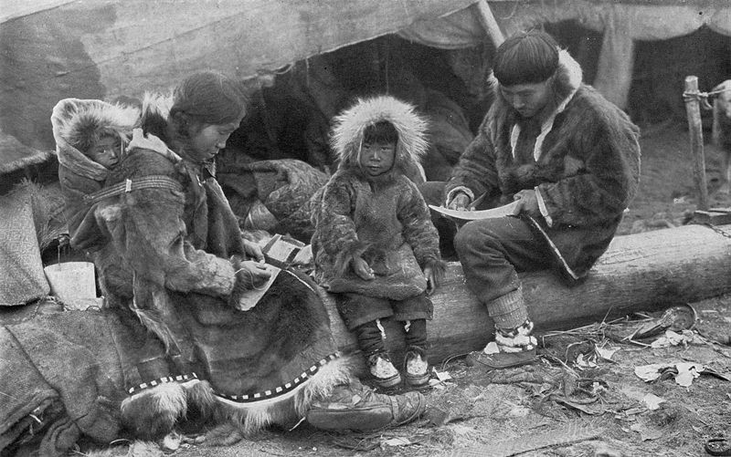
Clothing
Clothing enabled early humans to survive the Ice Age and to colonise the earth’s most severe climates.

Slide 49
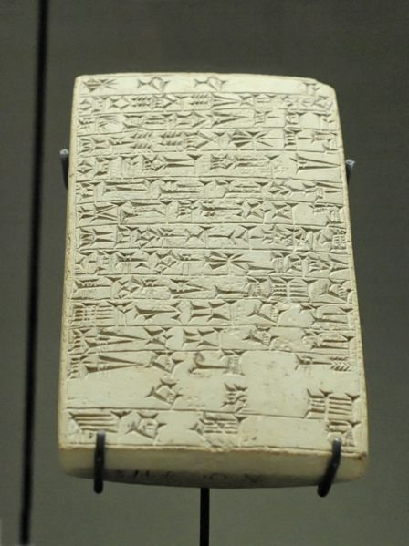

Language and writing
Language and writing have enabled humans to communicate with one another, and to record and pass on their ideas.

Slide 50
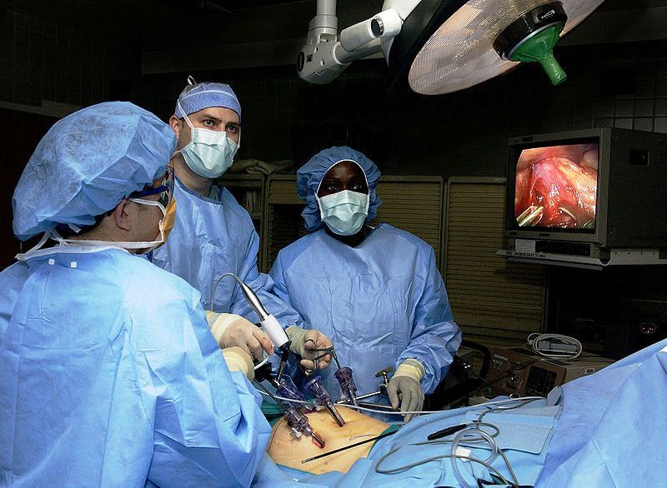
Medicine
Medicine has improved health and extended the human life span.

Slide 51
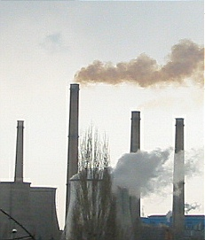
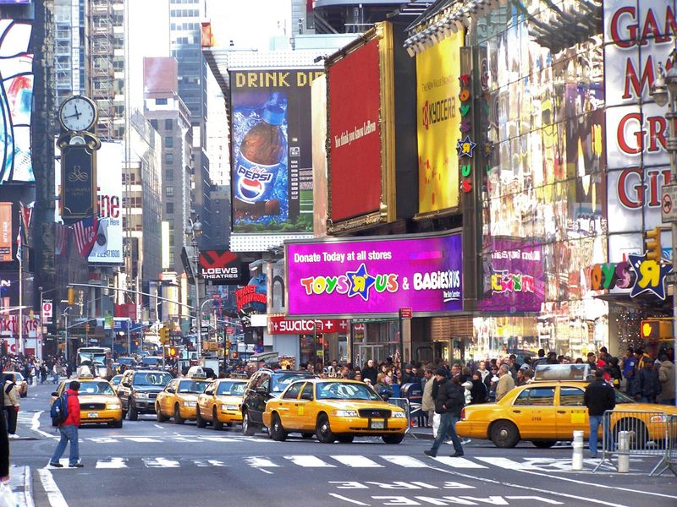
The industrial revolution
New technologies have led to industrialisation and the growth of huge cities.

Slide 52
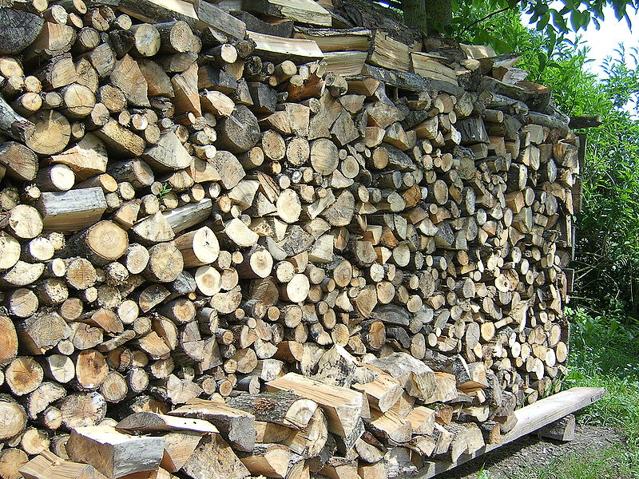
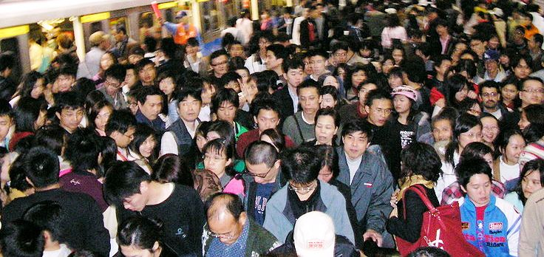

Consequences
As well as improving the living standards of some people, human activity has also resulted in over-population, pollution and the depletion of precious resources.

